Slide 1
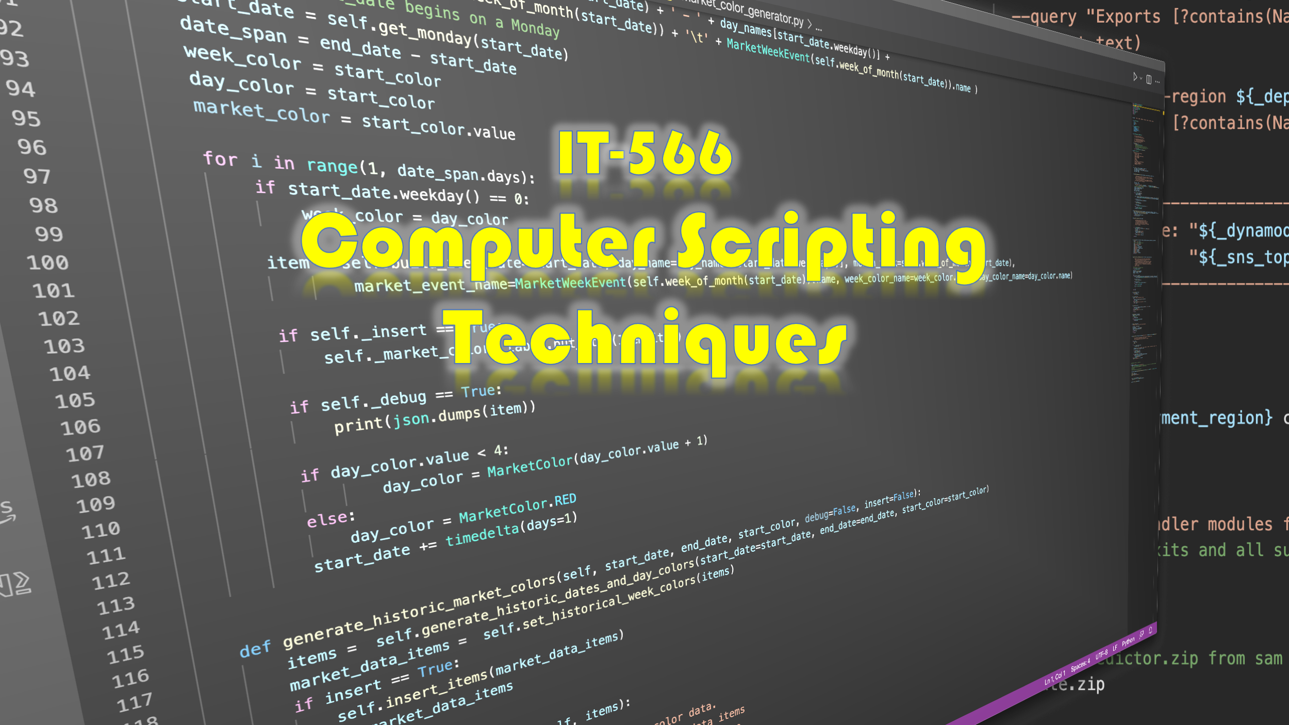

Slide 2
Week 2
Talking Points
Development Environment Setup and Configuration (Loose Ends)
Bash Build Script
Project Organization & Layout
Development Workflow
Topic

Slide 3
Development Environment Setup and Configuration (Loose Ends)
Package Managers
pipenv Setup, Usage & Why You Need It
tree Command
Configure ssh for GitHub
.bash_profile Helpful Settings

Slide 4
Package Managers

Slide 5

What Is A Package Manager?
An application that helps you install and manage software
GitHub, GitLab, SourceForge, PyPI, et. al.
Homebrew apt-get/apt
rpm, npm, pip, et. al.
Package Metadata
System (Windows, Linux, MacOS, Python)
Package Manager
Repository
Package
Dependencies

Slide 6
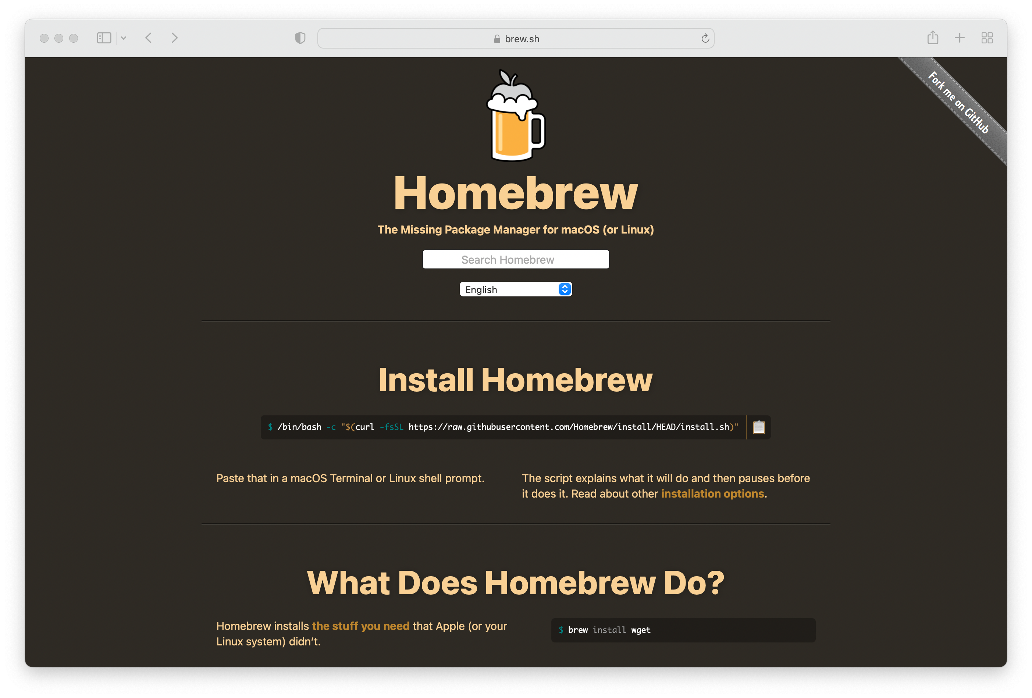
Homebrew MacOS (And Linux) Package Manager
Package Manager for MacOS
x86 & arm64
Simplifies Software Installation
Especially Unix utils
Developer tools
Linux, too
x86 (no arm64 binaries)

Slide 7





Linux Package Managers
apt-get / apt
rpm

Slide 8
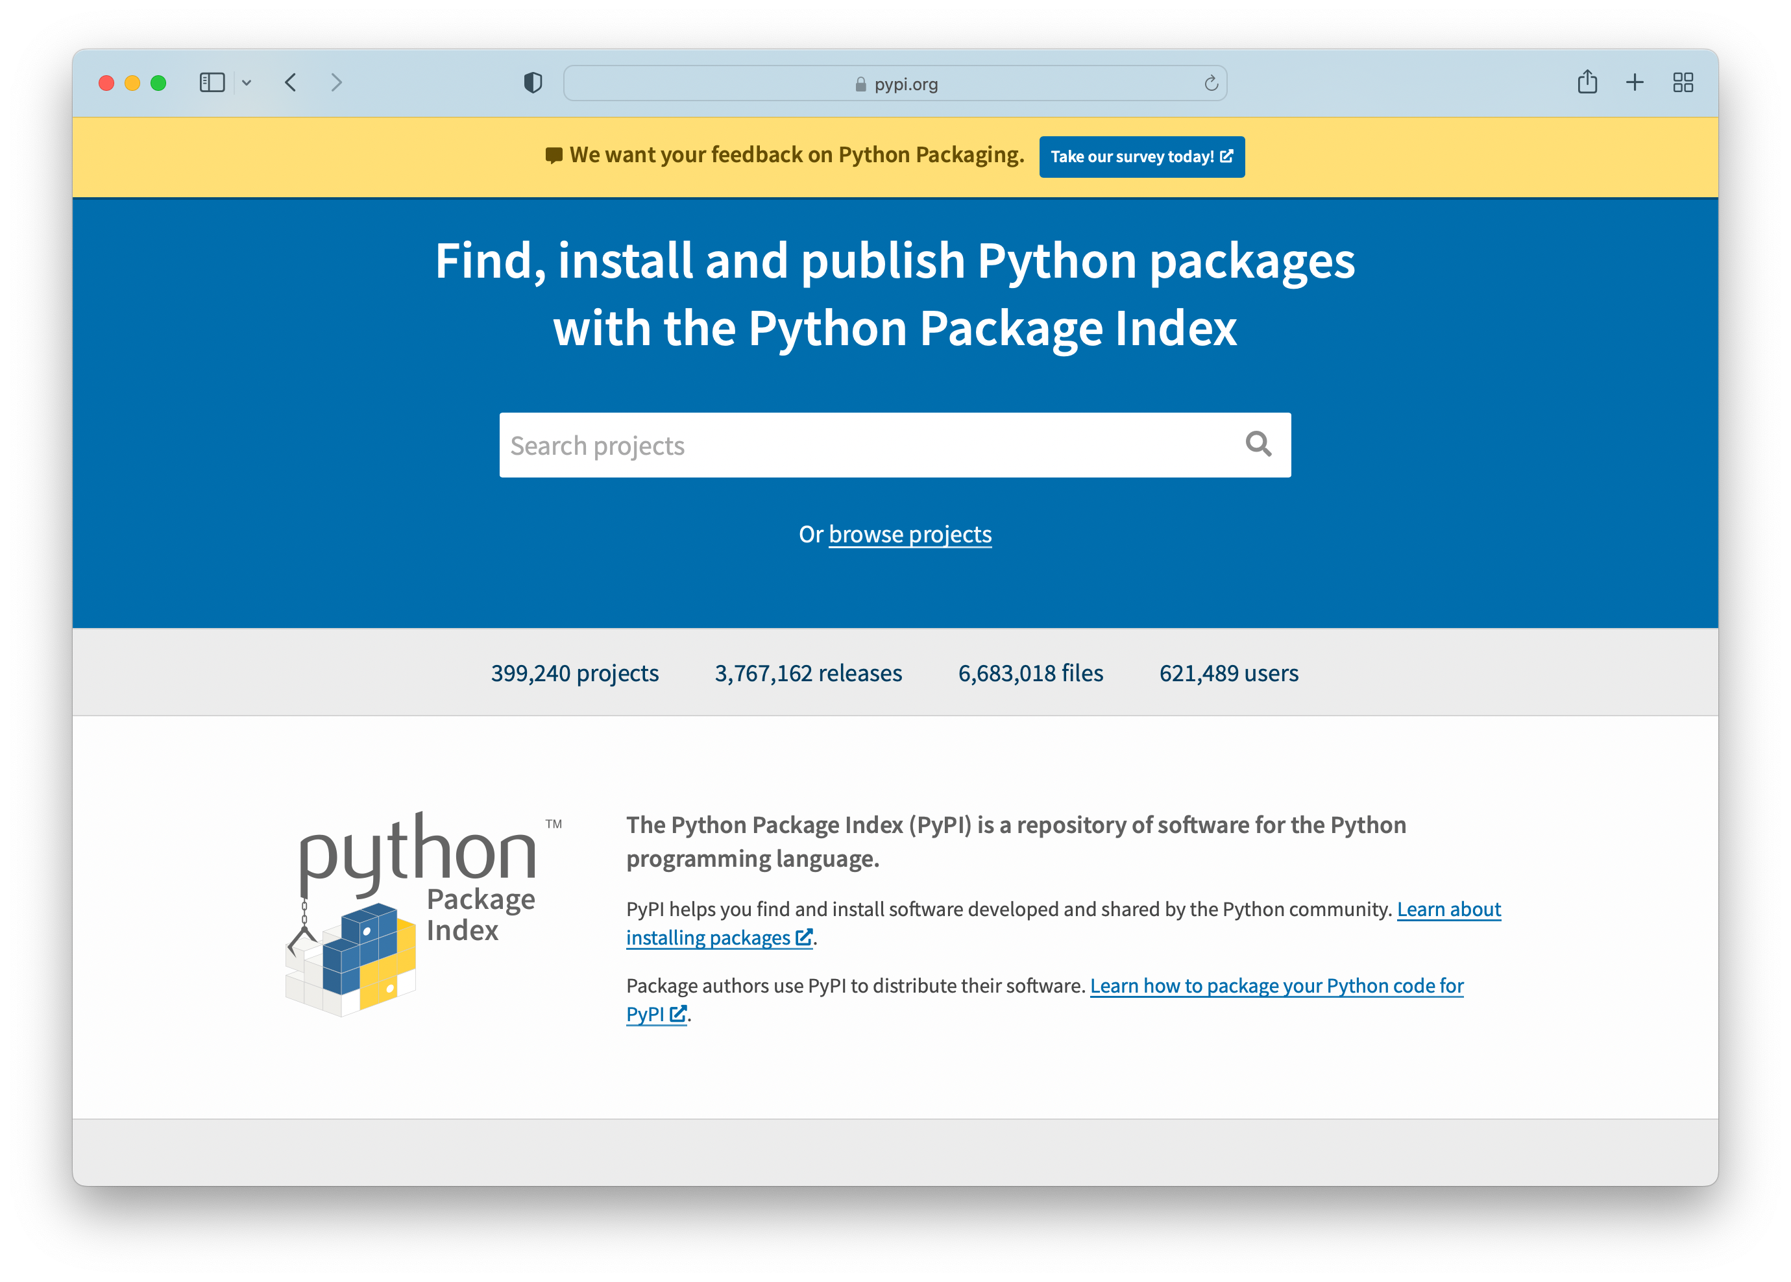
Python Package Manager — pip
pip or pip3
pip for Python 2
pip3 for Python 3
Generally…
PyPI
Python Package Repo

Slide 9
pipenv Setup, Usage, & Why You Need It

Slide 10
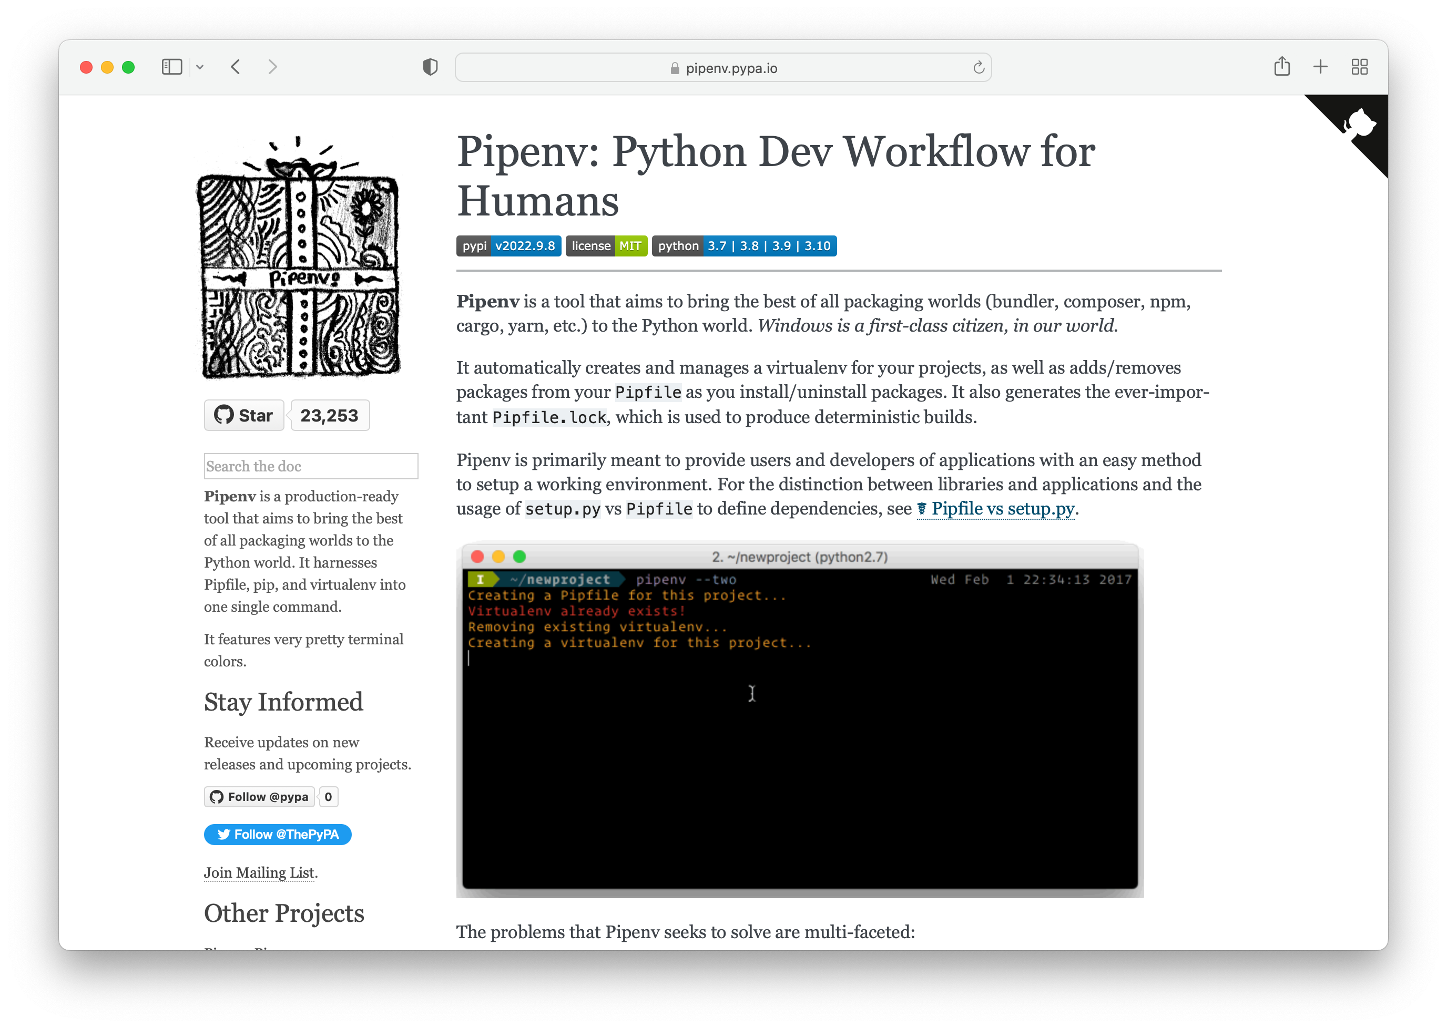
Pipenv — Why You Need It
Create and Manage Python Virtual Environments
Why?
You may have multiple python projects based on different Python versions
Helps manage and avoid python package dependency conflicts
Enables deterministic builds
With very few exceptions, avoid installing Python packages globally
Create a new venv with pipenv and install there

Slide 11
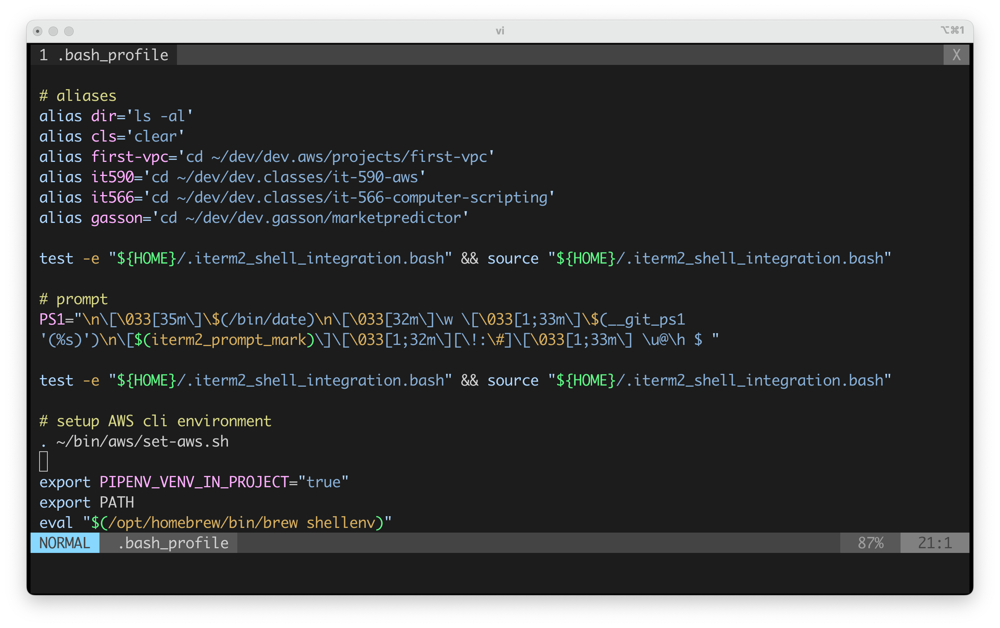
pipenv – Configuration and Usage
export the environment variable: PIPENV_VENV_IN_PROJECT=“true”
Restart shell
Usage
pipenv -- python 3
or be more specific
pipenv --python 3.6
pipenv --python 3.10
etc….
Install a package
pipenv install requests
This will create a Pipfile
…and a .venv directory

Slide 12

Oh Yeah? Show me!

Slide 13
tree Command

Slide 14
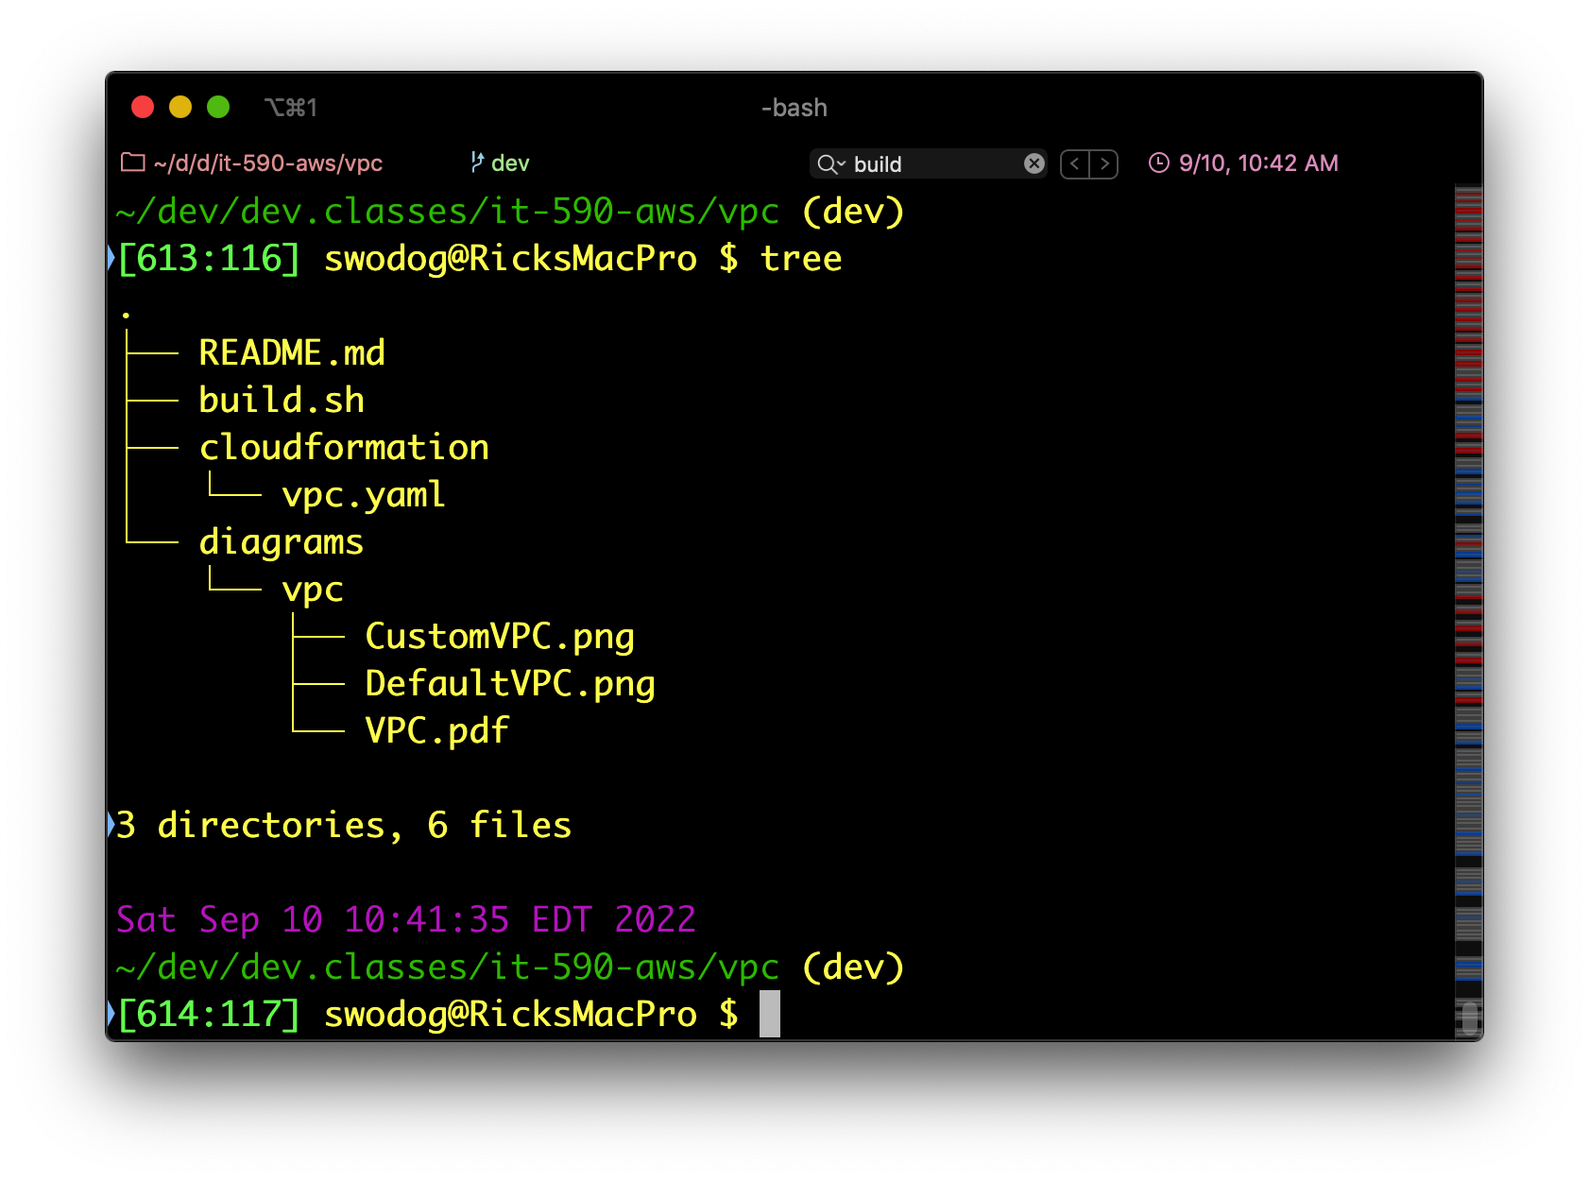
tree Command (MacOS)
Tree view of directory structure
Install with brew

Slide 15
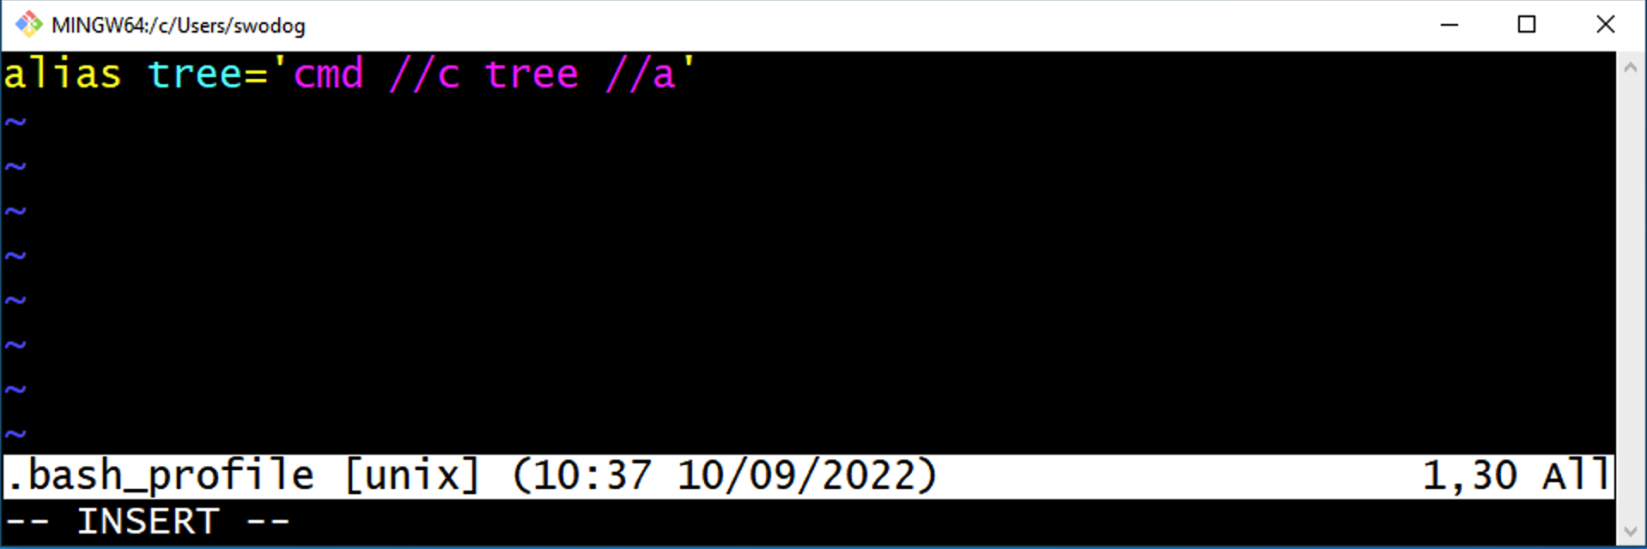
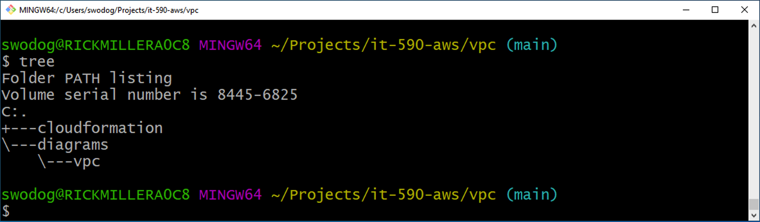
tree Command (Windows)
Add alias to tree command in .bash_profile
Comes with Windows
Must configure to use in git bash
Relaunch Git Bash

Slide 16
My A$$! Show me!

Slide 17
.bash_profile Helpful Settings

Slide 18
.bash_profile Helpful Settings
Command Aliases
Environment Variables
Fancy Prompt
Links to other shell scripts
Much, much, more…

Slide 19
Configure SSH for GitHub

Slide 20
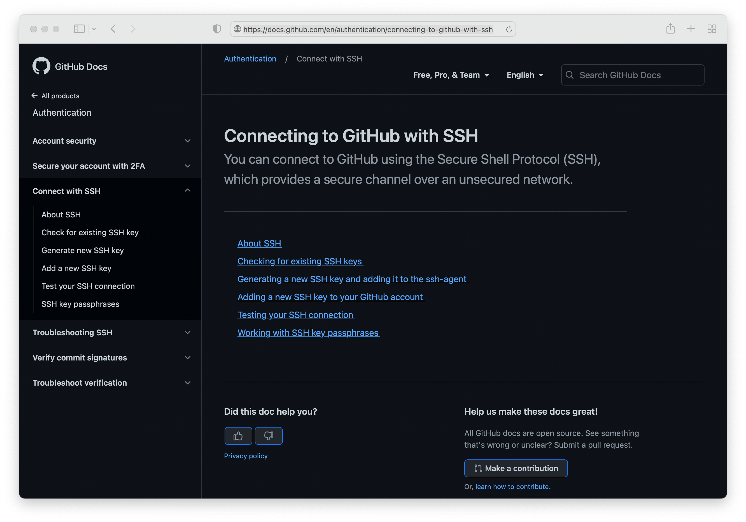
Configure SSH for GitHub
Secure Repository Connection
SSH Key Generation and Installation
Can be confusing
Let’s walk through

Slide 21

GitHub SSH Key Generation and Configuration

Slide 22
Project Organization & Layout
Directory Structure & Project Artifacts
Python Modules & Packages

Slide 23
Directory Structure & Project Artifacts

Slide 24
Project Organization and Layout

Slide 25
Bash Build Script

Slide 26
Bash Build Script
Topic

Slide 27
Development Workflow

Slide 28
Development Workflow
Topic

